Slide 1

SYSTEM
ENGINEERING
PROJECT
Submitted to:
-Dr. Ashish Kumar Dwivedi
Submitted by:
-Aditya Chaudhary (22dcs002)
-Tushar Agrawal (22ucs219)

Slide 2

TABLE OF CONTENTS
01
Project Description
02
System Design
03
System Implementation
04
System Testing

Slide 3
PROJECT DESCRIPTION
Introduction
Objectives
Features
Importance
API Creation and Testing

Slide 4
INTRODUCTION
StudyNotion is a fully functional ed-tech platform that enables users to create, consume, and rate educational content.
The platform is built using the MERN stack, which includes ReactJS, NodeJS, MongoDB, and ExpressJS.

Slide 5
OBJECTIVES
A seamless and interactive learning experience for students, making education more accessible and engaging.
A platform for instructors to showcase their expertise and connect with learners across the globe.

Slide 6
FEATURES
For Instructors:
Sign Up: Easily register for an account with necessary details.
Course Creation: Craft and curate courses with diverse content formats.
Course Publication: Effortlessly publish courses for student accessibility.

Slide 7
FEATURES
For Students:
Registration: Swiftly create accounts with required information.
Course Exploration: Access a variety of courses to explore diverse subjects.
Course Purchase: Seamlessly select and purchase courses aligned with interests.
Content Accessibility: Instant access to course content, including video lectures and reading materials, for an enriching learning experience.

Slide 8
IMPORTANCE
StudyNotion is a versatile and intuitive edtech platform that is designed to provide an immersive learning experience to students and a platform for instructors to showcase their expertise.
StudyNotion's project importance lies in its commitment to continuous improvement. By detailing future enhancements, their impact, and implementation timelines, it ensures innovation aligned with user needs, fostering a dynamic learning environment.

Slide 9
API Creation and Testing
The heart of our project lies in the exploration of API creation and testing.
The StudyNotion platform API is designed following the REST architectural style.
The sample API requests and responses provided above illustrate how each endpoint will function and what kind of data it will accept or return.
By leveraging tools like Postman API we demonstrate the seamless functionality of APIs, ensuring they deliver accurate responses and meet the platform's requirements effectively.

Slide 10

System Design
Architecture Overview
System Components
Data Flow
Security Measures
Overview of full stack MERN architecture used in StudyNotion platform.
Explaining major components and various interactions.
Illustration of flow of data within the system, mainly from user interaction to database storage.
Discussing the security measures implemented in the system to protect user data and ensure secure interactions.

Slide 11
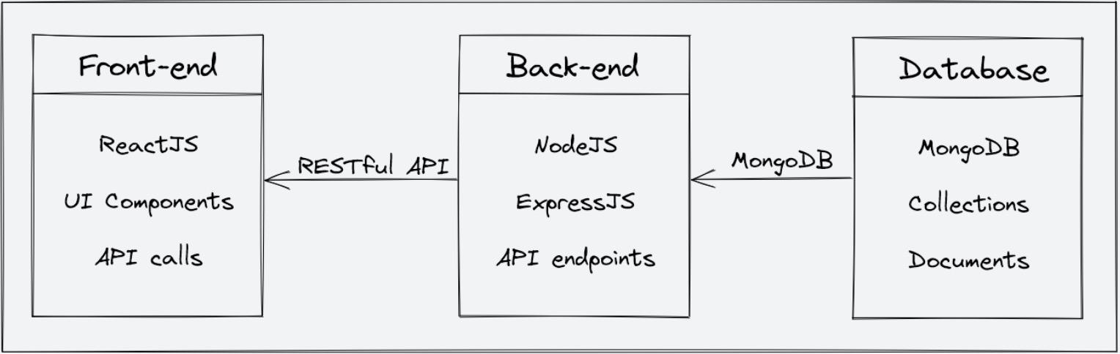
Architecture Overview
Here is a high-level diagram that illustrates the architecture of the StudyNotion ed-tech platform:

Slide 12
System Components
Backend
APIs

Slide 13
System Component(Backend)
Description of Backend Architecture
Built using Node.js, Express,js and MongoDB as primary database.
Node.js is a popular JavaScript runtime that allows JS code to run outside browser.
Express.js is a web application framework that simplifies the process of building web applications in Node.js.
MongoDB is a popular NoSQL database that allows for flexible data storage and retrieval.

Slide 14
System Component(Backend)
Features and Functionality
User authentication and authorization: Students and instructors can sign up and log in to the platform using their email addresses and password. The platform also supports OTP (One-Time Password) verification and forgot password functionality for added security.
Course management: Instructors can create, read, update, and delete courses, as well as manage course content and media. Students can view and rate courses.
Payment Integration: Students will purchase and enroll on courses by completing the checkout flow that is followed by Stripe integration for payment handling.
Cloud-based media management: StudyNotion uses Cloudinary, a cloud-based media management service, to store and manage all media content, including images, videos, and documents.

Slide 15
System Component(Backend)
Library and Tools used:
JWT: JSON Web Tokens are used for authentication and authorization, providing a secure and reliable way to manage user credential.
Bcrypt: It is used for password hashing, adding and extra layer of security to user password.
Mongoose: It is used as an Object Data Modeling Library, providing a way to interact with MongoDB using JavaScript.
Cloudinary: It is used to store and manage media related content.
Dotenv: It is used for storing secrets.
Nodemailer: It is used to send automatic email after triggering an event.
Stripe: It is used for Payment gateway process.

Slide 16
System Components(APIs)
The StudyNotion platform API is designed following the REST architectural style. The API is implemented using Node.js and Express.js. It uses JSON for data exchange and follows standard HTTP request methods such as GET, POST, PUT, and DELETE.
API: Application Programming Interface
REST: Representational State Transfer

Slide 17
System Components(APIs)
Sample list of endpoints and their functionalities:
/api/auth/signup (POST) - Create a new user (student or instructor) account.
/api/auth/login (POST) – Log in using existing credentials and generate a JWT token.
/api/auth/verify-otp (POST) - Verify the OTP sent to the user's registered email.
/api/auth/forgot-password (POST) - Send an email with a password reset link to the registered email.
/api/courses (GET) - Get a list of all available courses.
/api/courses/:id (GET) - Get details of a specific course by ID.
/api/courses (POST) - Create a new course.
/api/courses/:id (PUT) - Update an existing course by ID.
/api/courses/:id (DELETE) - Delete a course by ID.
/api/courses/:id/rate (POST) - Add a rating (out of 5) to a course.

Slide 18
System Components(APIs)
Sample API Requests and Responses:
1. GET /api/courses: Get all courses ● Response: A list of all courses in the database
2. GET /api/courses/:id: Get a single course by ID ● Response: The course with the specified ID
3. POST /api/courses: Create a new course ● Request: The course details in the request body
● Response: The newly created course
4. PUT /api/courses/:id: Update an existing course by ID ● Request: The updated course details in the request body ● Response: The updated course
5. DELETE /api/courses/:id: Delete a course by ID
● Response: A success message indicating that the course has been deleted.

Slide 19
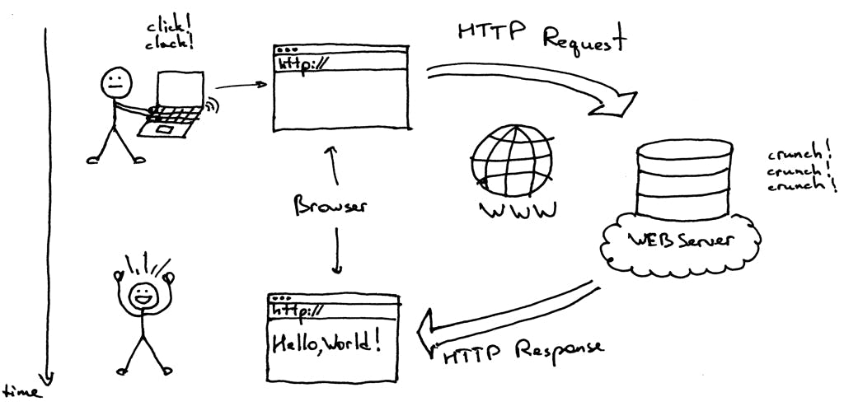
Data Flow
Client-Server Communication

Slide 20
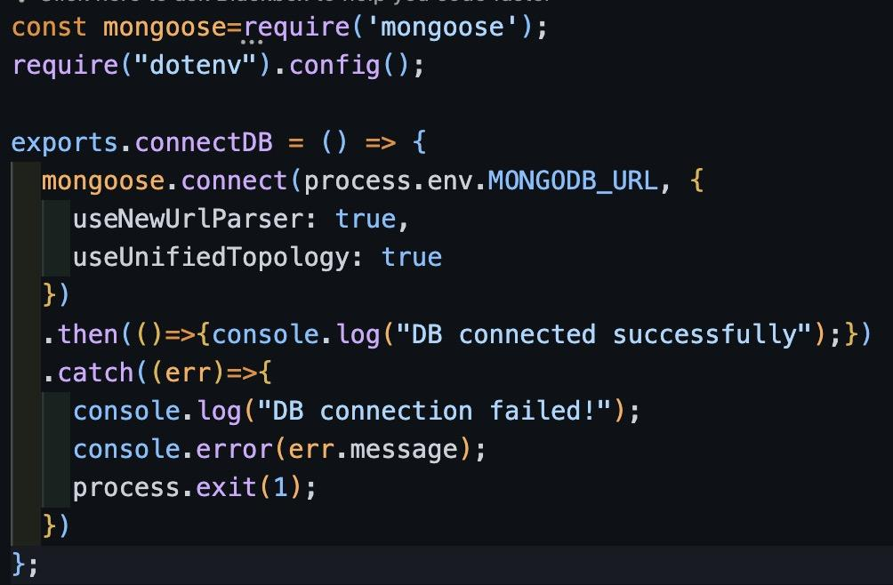
Data Flow
Database Connectivity
Connect method of mongoose object establishes a connection to the database.
A promise is returned which if resolved then message will be printed
If promise isn’t resolved then error message will be printed on the console.
MongoDB Compass Demo

Slide 21
Security Measures
Authentication
Authorization
Data Encryption
CORS

Slide 22
Technology Stack
Development Process
Code Structure
Code Review
System Implementation
Technology used in each layer of system.
Development process followed.
Structure of codebase, including folder organization and code patterns.
Major code for each part of system.

Slide 23
Technology Stack
Backend: Node.js and Express.js
Frontend: React.js
Database: MongoDB
Deployment: Frontend( Vercel ) & Backend( Render )

Slide 24



Development Process
STAGE 1
STAGE 2
STAGE 3
Planning and Requirement Analysis
Defining Requirements
Design

Slide 25
Development Process
STAGE 4
STAGE 5
STAGE 6
Development
Testing
Deployment and Maintenance

Slide 26
Code Structure and Review
Live Demo!
Github Link for Codebase: StudyNotion Codebase
Deployed Website: StudyNotion Website

Slide 27
System Testing
Approach
Test Cases
Tools Used
Live Testing
JSON Objects
Media Files
End-to-End testing
Postman API
Frontend
Postman Tutorial
Testing of system

Slide 28
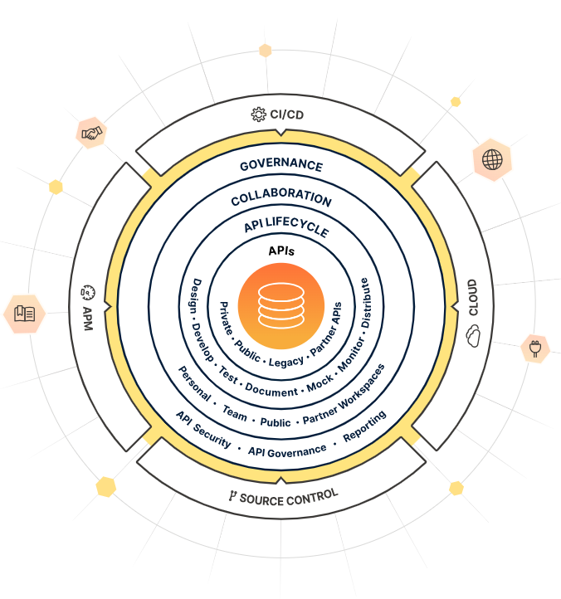

What is Postman?
POSTMAN Tutorial
Postman is an API platform for building and using APIs. Postman simplifies each step of the API lifecycle and streamlines collaboration so you can create better APIs—faster.

Slide 29

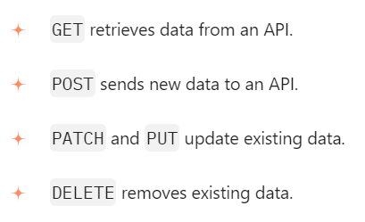
API REQUESTS COMMON METHODS

Slide 30
COLLECTIONS
VARIABLES
ENVIRONMENTS
CONSOLE
Pre-Request Script
Test Script
Collection is a group of API requests
Elements that can store different values
Environment is a set of key value pairs
console.log()
console.info()
After a response is received as a test script under the Tests tab.
Before a request is sent to the server, as a pre-request script under the Pre-request script tab.

Slide 31
System Testing Using Postman API tool
Live Demo!
Github Link for Codebase: StudyNotion Codebase
Deployed Website: StudyNotion Website

Slide 32
System Testing
Using Frontend
Live Demo!
Github Link for Codebase: StudyNotion Codebase
Deployed Website: StudyNotion Website

Slide 33
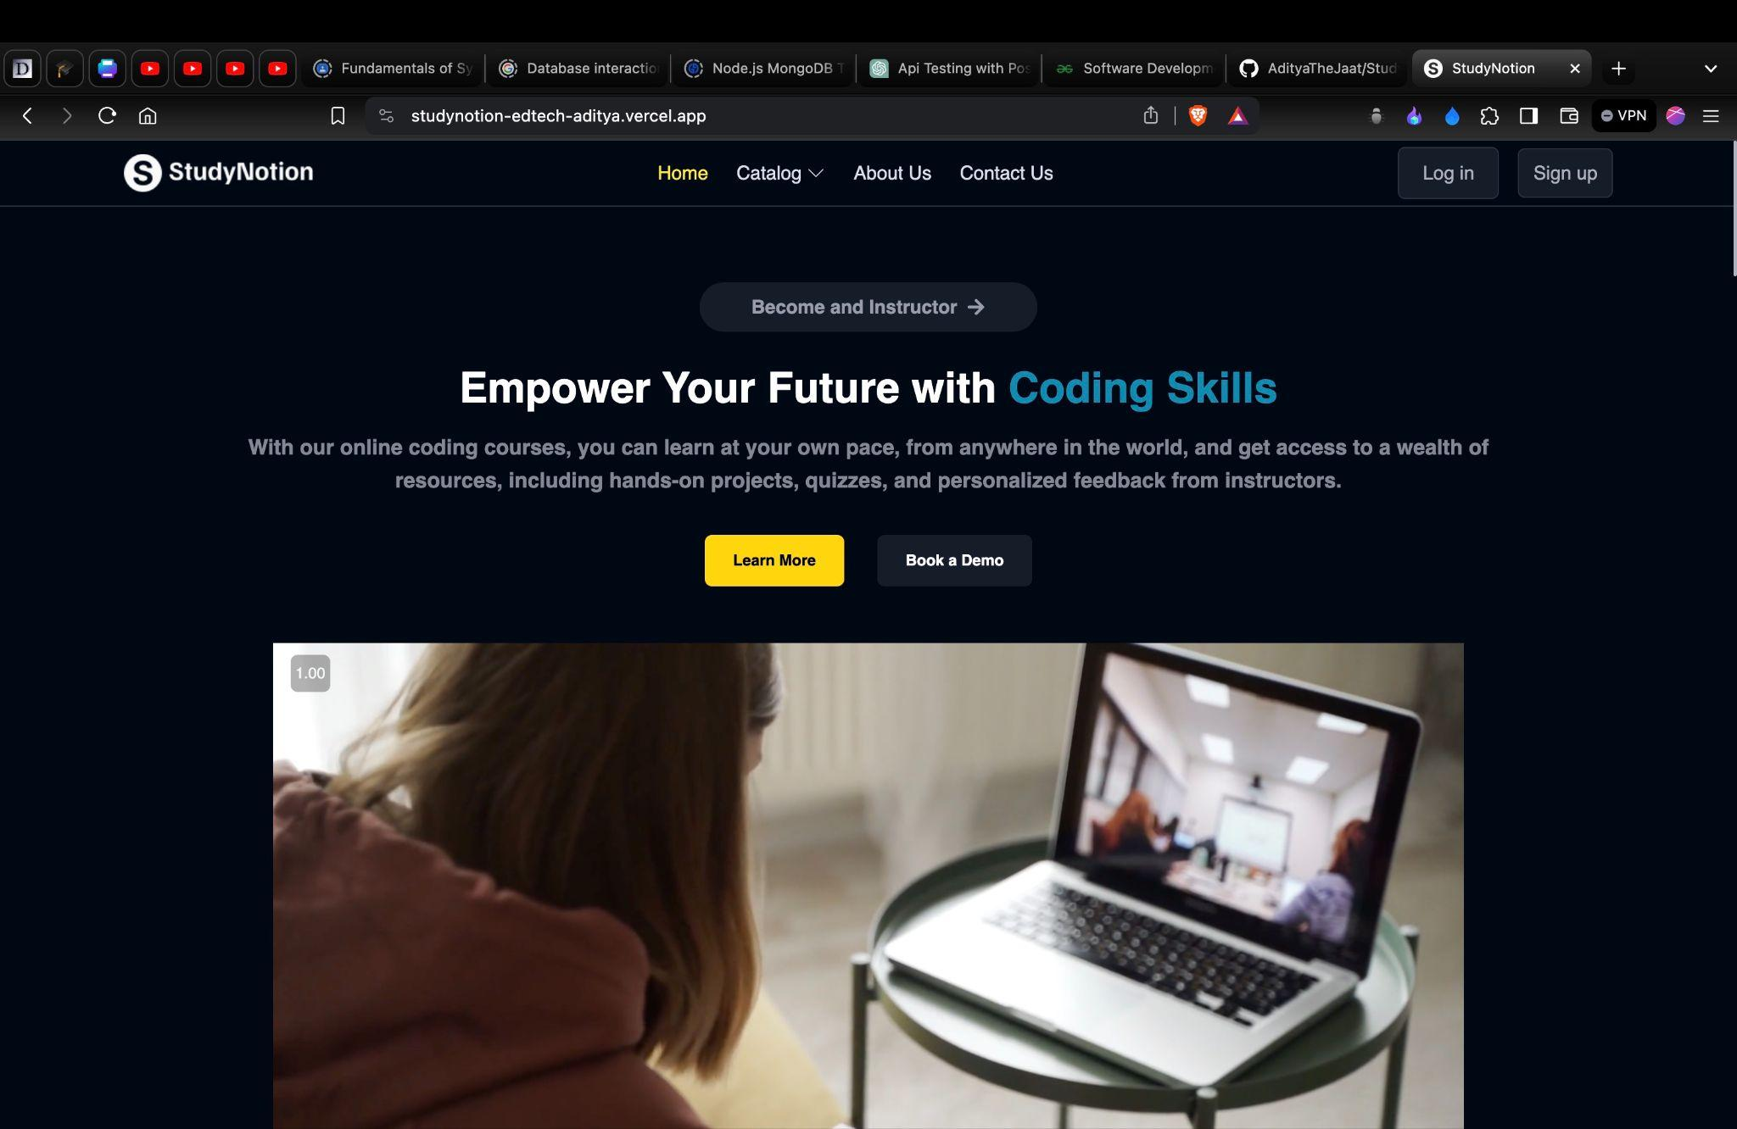
THANKS
Github Link for Codebase: StudyNotion Codebase
Deployed Website: StudyNotion Website

